Slide 1

DIGITAL LOGIC DESIGN (111776)
Dr. Owais Hussain

Slide 2

Agenda
Clock
Clock as Enable Input
SR Flip Flop
D Flip Flop
JK Flip Flop
JK Flip Flop Truth Table
T Flip Flop

Slide 3
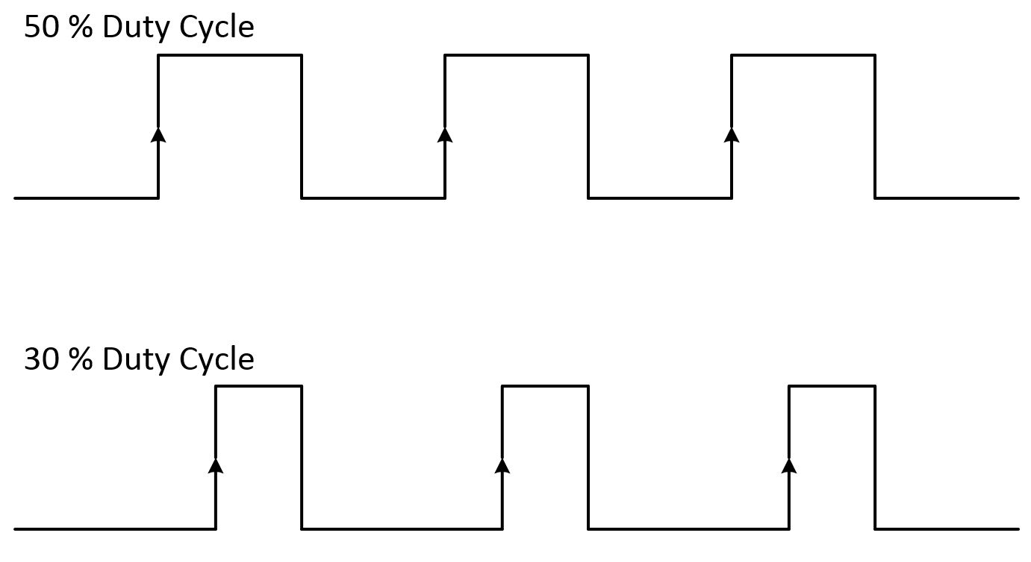
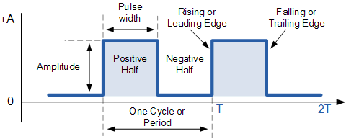
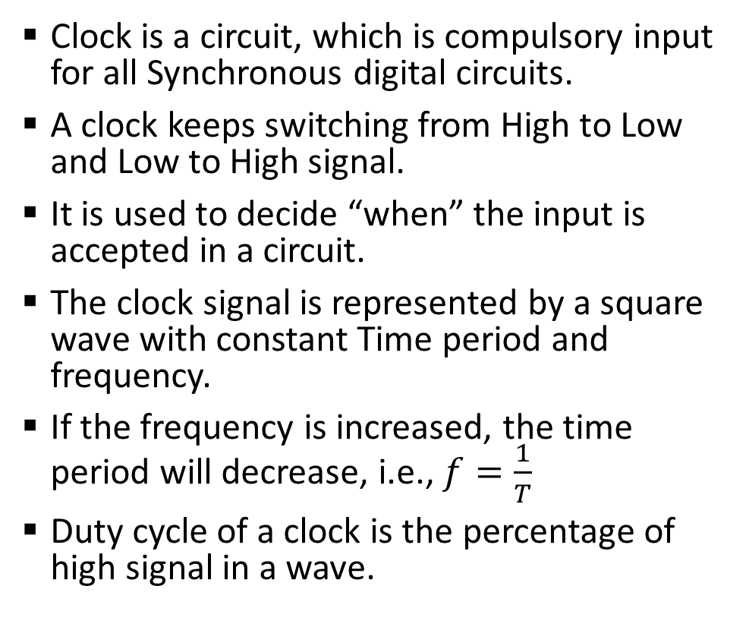
Sample 2
Clock
Clock is a circuit, which is compulsory input for all Synchronous digital circuits.
A clock keeps switching from High to Low and Low to High signal.
It is used to decide “when” the input is accepted in a circuit.
The clock signal is represented by a square wave with constant Time period and frequency.
If the frequency is increased, the time period will decrease, i.e., $f=\frac{1}{T}$
Duty cycle of a clock is the percentage of high signal in a wave.

Slide 4
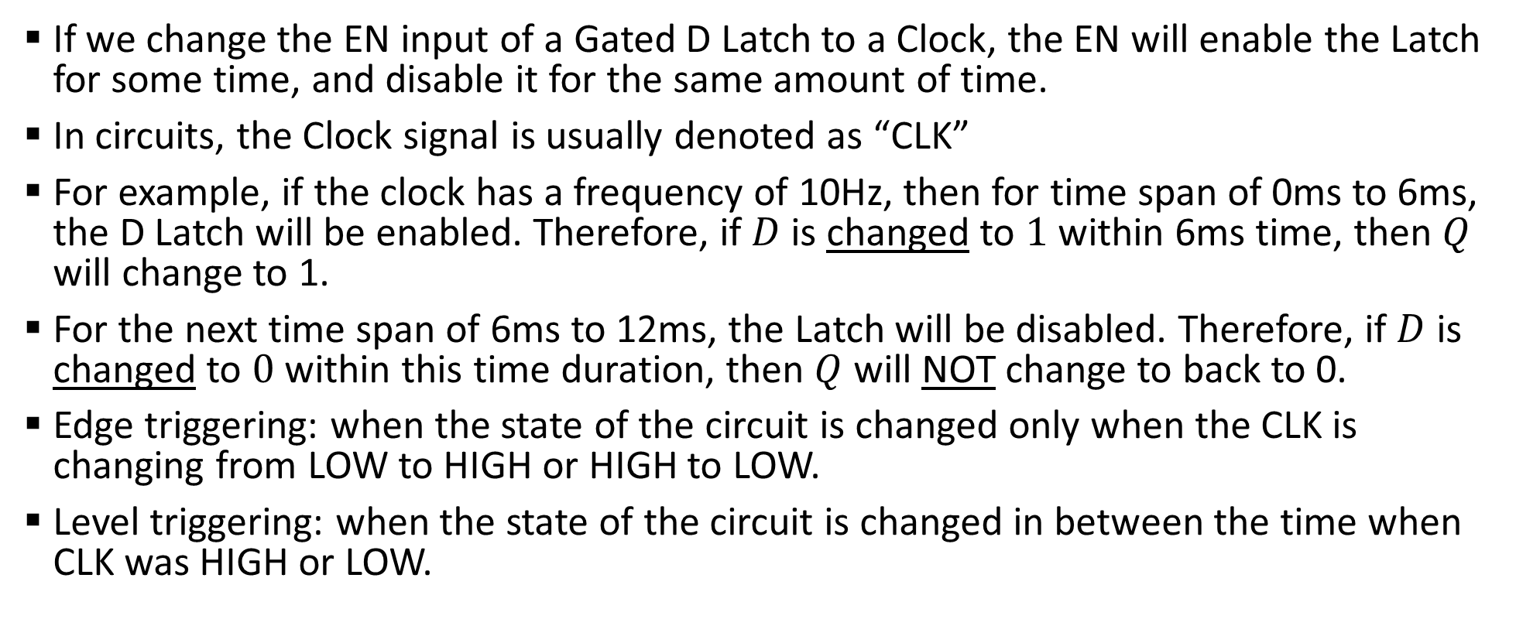
Sample 2
Clock as ENable Input
If we change the EN input of a Gated D Latch to a Clock, the EN will enable the Latch for some time, and disable it for the same amount of time.
In circuits, the Clock signal is usually denoted as “CLK”
For example, if the clock has a frequency of 10Hz, then for time span of 0ms to 6ms, the D Latch will be enabled. Therefore, if $D$ is changed to $1$ within 6ms time, then $Q$ will change to 1.
For the next time span of 6ms to 12ms, the Latch will be disabled. Therefore, if $D$ is changed to $0$ within this time duration, then $Q$ will NOT change to back to 0.
Edge triggering: when the state of the circuit is changed only when the CLK is changing from LOW to HIGH or HIGH to LOW.
Level triggering: when the state of the circuit is changed in between the time when CLK was HIGH or LOW.

Slide 5
Sample 2
Flip Flops
A Flip Flop is a Latch with a CLK signal.
The problem with Latches is that they do not shift immediately as the EN is changed. Meaning they work on level triggering. So, the user has to first change EN to 1, then change the input.
The Flip Flops solve this problem because they work on edge triggering. Therefore, as soon as the CLK is HIGH, the circuit activates and works on whatever the input may be.

Slide 6
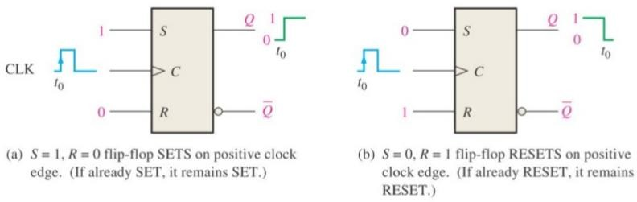
Sample 2
SR Flip Flop
An SR Flip Flop is Simply a Gated SR Latch with CLK provided as EN signal.

Slide 7
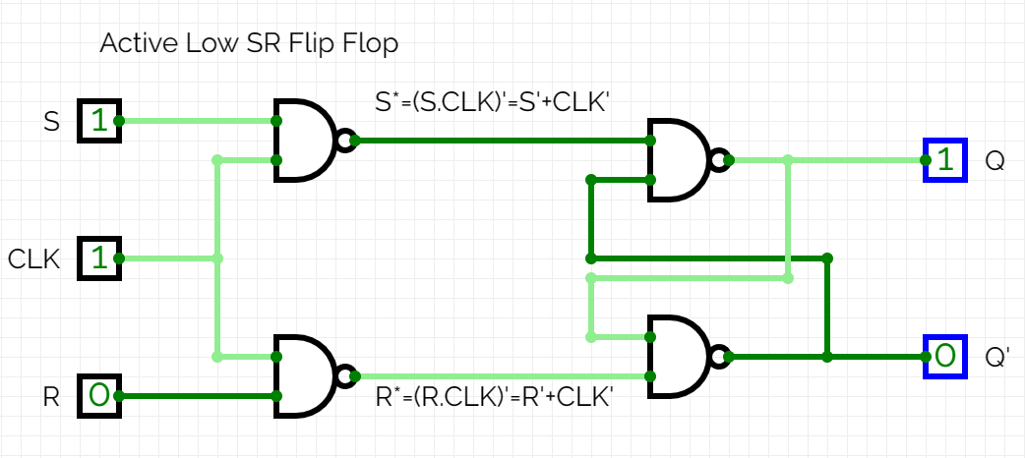
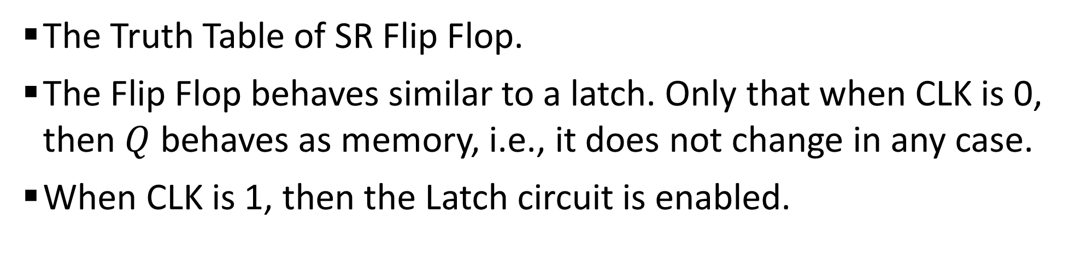
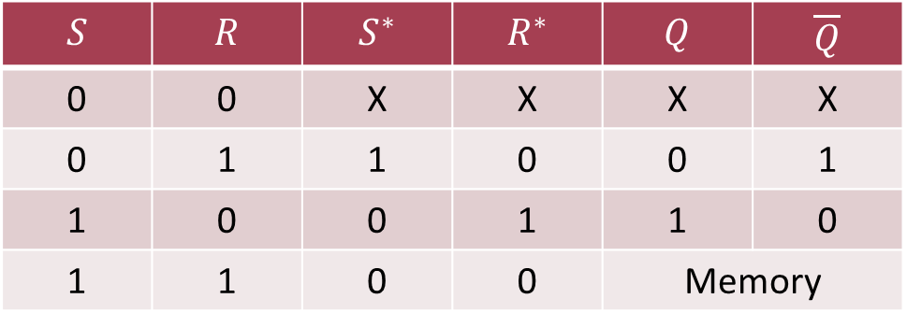
Sample 2
SR Flip Flop
The Truth Table of SR Flip Flop.
The Flip Flop behaves similar to a latch. Only that when CLK is 0, then $Q$ behaves as memory, i.e., it does not change in any case.
When CLK is 1, then the Latch circuit is enabled.
$$S$$ | $$R$$ | $$S^{∗}$$ | $$R^{∗}$$ | $$Q$$ | $$\overline{Q}$$
0 | 0 | X | X | X | X
0 | 1 | 1 | 0 | 0 | 1
1 | 0 | 0 | 1 | 1 | 0
1 | 1 | 0 | 0 | Memory

Slide 8
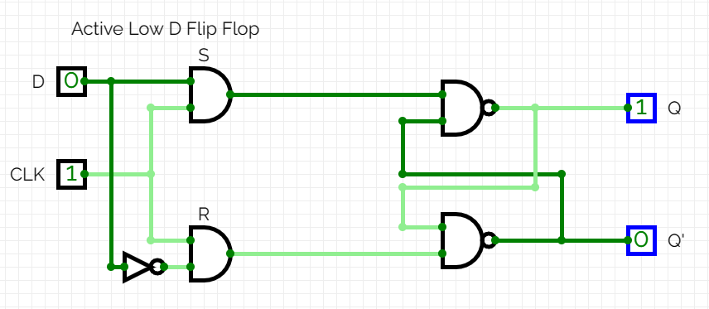
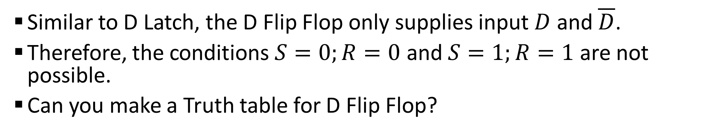
Sample 2
D Flip Flop
Similar to D Latch, the D Flip Flop only supplies input $D$ and $\overline{D}$.
Therefore, the conditions $S=0;R=0$ and $S=1;R=1$ are not possible.
Can you make a Truth table for D Flip Flop?
Notes:
CircuitVerse - Digital Circuit Simulator online

Slide 9
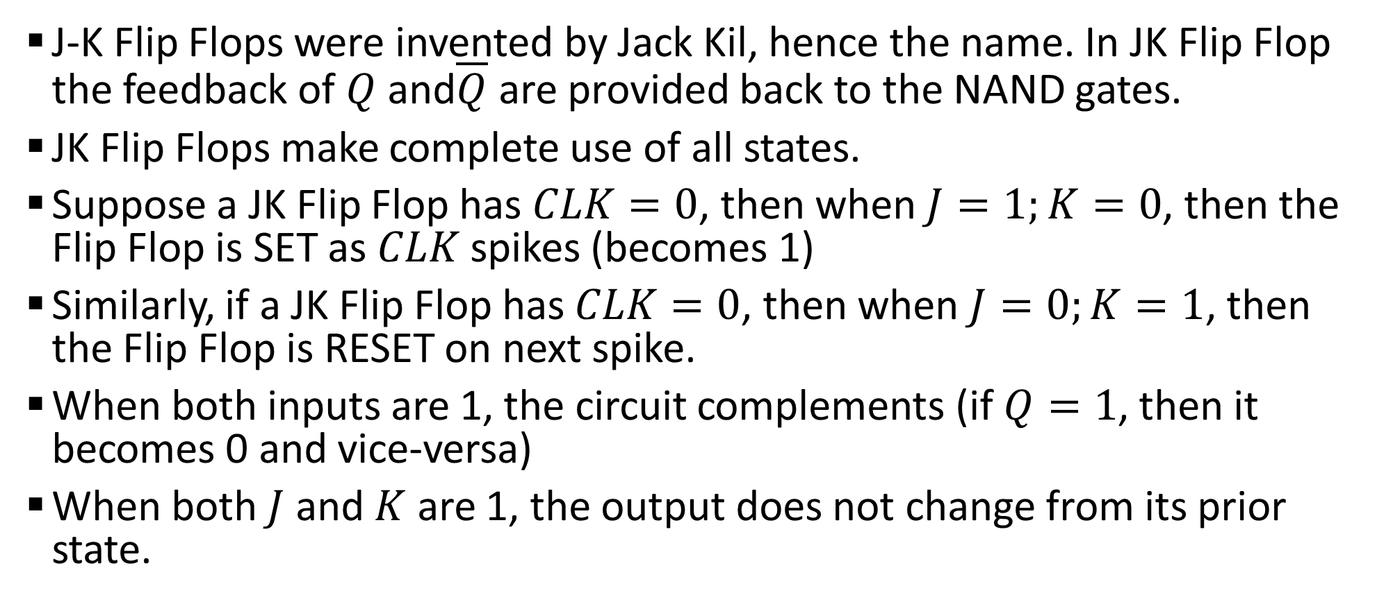
Sample 2
JK Flip Flop
J-K Flip Flops were invented by Jack Kil, hence the name. In JK Flip Flop the feedback of $Q$ and$\overline{Q}$ are provided back to the NAND gates.
JK Flip Flops make complete use of all states.
Suppose a JK Flip Flop has $CLK=0$, then when $J=1;K=0$, then the Flip Flop is SET as $CLK$ spikes (becomes 1)
Similarly, if a JK Flip Flop has $CLK=0$, then when $J=0;K=1$, then the Flip Flop is RESET on next spike.
When both inputs are 1, the circuit complements (if $Q=1$, then it becomes 0 and vice-versa)
When both $J$ and $K$ are 1, the output does not change from its prior state.

Slide 10
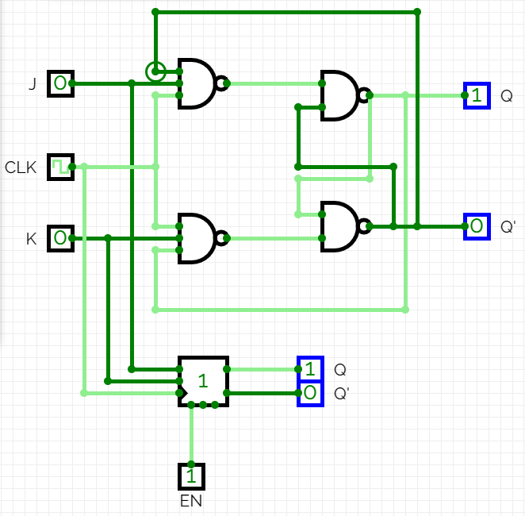
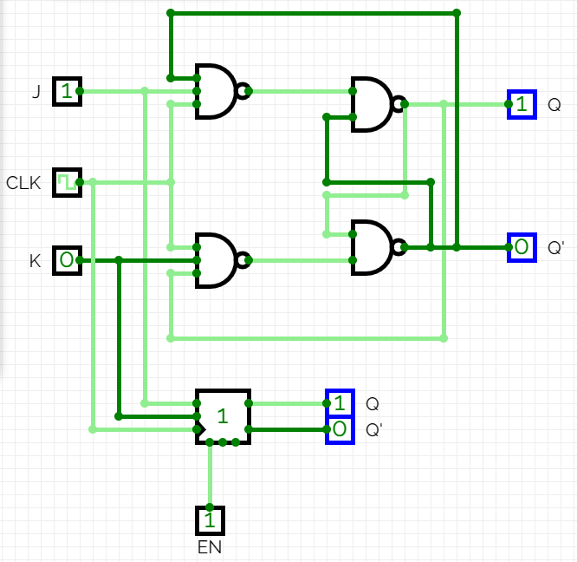
Sample 2
JK Flip Flop

Slide 11
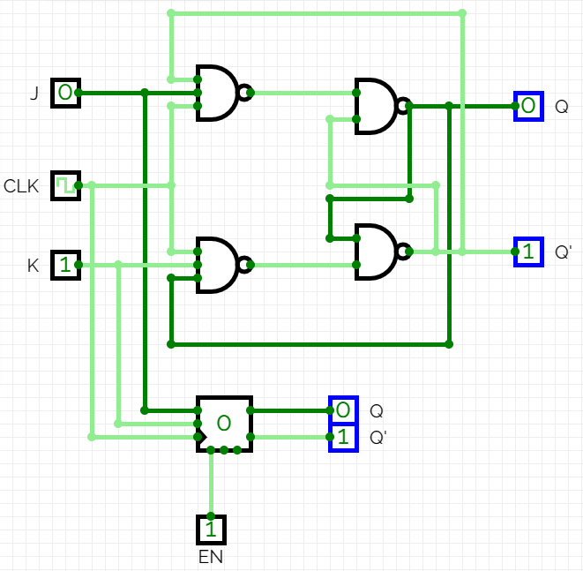
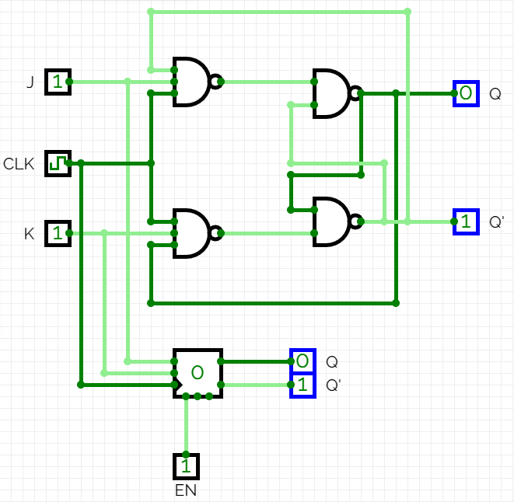
Sample 2
JK Flip Flop

Slide 12
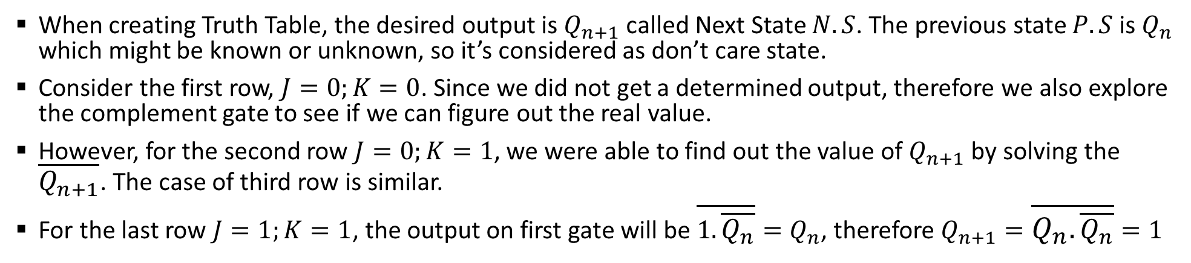
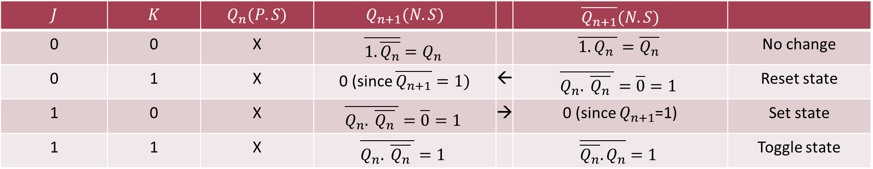
Sample 2
JK Flip Flop Truth Table
When creating Truth Table, the desired output is $Q_{n+1}$ called Next State $N.S$. The previous state $P.S$ is $Q_{n}$ which might be known or unknown, so it’s considered as don’t care state.
Consider the first row, $J=0;K=0$. Since we did not get a determined output, therefore we also explore the complement gate to see if we can figure out the real value.
However, for the second row $J=0;K=1$, we were able to find out the value of $Q_{n+1}$ by solving the $\overline{Q_{n+1}}$. The case of third row is similar.
For the last row $J=1;K=1$, the output on first gate will be $\overline{1.\overline{Q_{n}}}=Q_{n}$, therefore $Q_{n+1}=\overline{Q_{n}.\overline{Q_{n}}}=1$
$$J$$ | $$K$$ | $$Q_{n}(P.S)$$ | $$Q_{n+1}(N.S)$$ |  | $$\overline{Q_{n+1}}(N.S)$$
0 | 0 | X | $$\overline{1.\overline{Q_{n}}}=Q_{n}$$ |  | $$\overline{1.Q_{n} }=\overline{Q_{n}}$$ | No change
0 | 1 | X | 0 (since $\overline{Q_{n+1}}=1)$ | ← | $$\overline{Q_{n}. \overline{Q_{n}} }=\overline{0}=1$$ | Reset state
1 | 0 | X | $$\overline{Q_{n}. \overline{Q_{n}} }=\overline{0}=1$$ | → | 0 (since $Q_{n+1}$=1) | Set state
1 | 1 | X | $$\overline{Q_{n}. \overline{Q_{n}} }=1$$ |  | $$\overline{\overline{Q_{n}}.Q_{n}}=1$$ | Toggle state

Slide 13
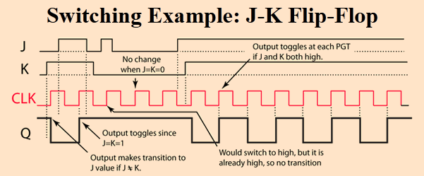
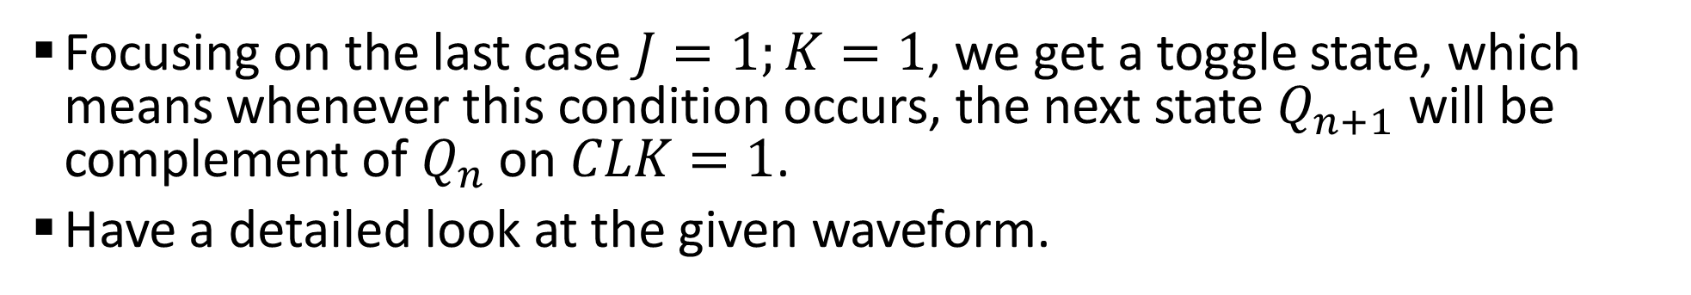
Sample 2
JK Flip Flop Truth Table
Focusing on the last case $J=1;K=1$, we get a toggle state, which means whenever this condition occurs, the next state $Q_{n+1}$ will be complement of $Q_{n}$ on $CLK=1$.
Have a detailed look at the given waveform.

Slide 14
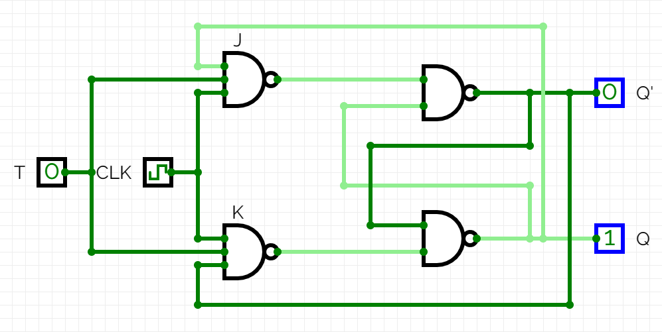
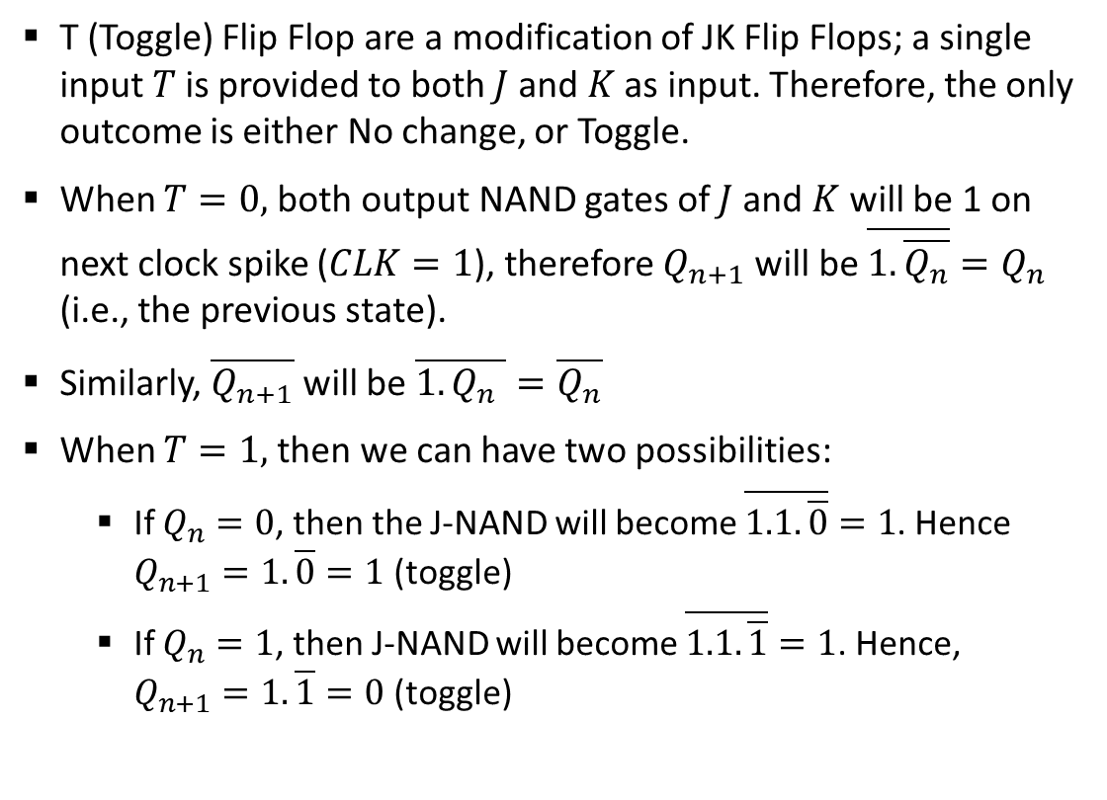
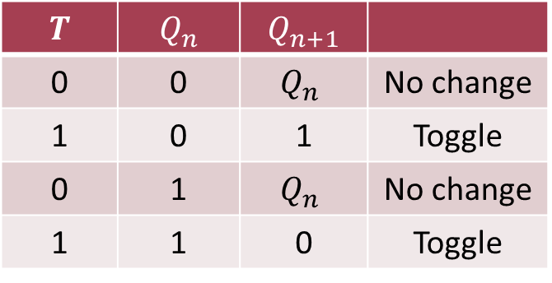
Sample 2
T Flip Flop
T (Toggle) Flip Flop are a modification of JK Flip Flops; a single input $T$ is provided to both $J$ and $K$ as input. Therefore, the only outcome is either No change, or Toggle.
When $T=0,$both output NAND gates of $J$ and $K$ will be 1 on next clock spike ($CLK=1$), therefore $Q_{n+1}$ will be $\overline{1.\overline{Q_{n}}}=Q_{n}$ (i.e., the previous state).
Similarly, $\overline{Q_{n+1}}$ will be $\overline{1.Q_{n} }=\overline{Q_{n}}$
When $T=1,$ then we can have two possibilities:
If $Q_{n}=0$, then the J-NAND will become $\overline{1.1.\overline{0}}=1$. Hence $Q_{n+1}=1.\overline{0}=1$ (toggle)
If $Q_{n}=1$, then J-NAND will become $\overline{1.1.\overline{1}}=1$. Hence, $Q_{n+1}=1.\overline{1}=0$ (toggle)
$$T$$ | $$Q_{n}$$ | $$Q_{n+1}$$
0 | 0 | $$Q_{n}$$ | No change
1 | 0 | 1 | Toggle
0 | 1 | $$Q_{n}$$ | No change
1 | 1 | 0 | Toggle

Slide 15



THANK YOU
Owais Hussain
+92 345-3174270
owais.hussain@kiet.edu.pk
https://www.researchgate.net/profile/Owais-Hussain-3

